Slide 1
2019 CIRCULAR ECONOMY DEVELOPMENT FORUM
Nanjing, October 20 2019
Perspectives and Barriers
of the Circular Economy Technologies in the Global Market
Corrado Clini
Former Minister for the Environment of Italy
Senior Advisor Global Energy Interconnection Development and Cooperation Organization
(executive summary)

Slide 2
FROM LINEAR TO CIRCULAR ECONOMY
The linear model of production and consumption - take, make, and dispose – has dominated the economic development and growth narrative since the beginning of the Third Industrial Revolution.
Linear economic thinking fails to tackle the threats of resource scarcity and environmental degradation while traditional indicators do not incorporate upfront environmental damage and environmental externalities.
According to the International Resource Panel Report, global material resource usage, which was nearing 90 billion tonnes in 2017, is forecast to double between 2015 and 2050. “Resource efficiency policies and initiatives can cut resource usage by 26 per cent and reduce greenhouse gas emissions by an additional 15-20 per cent, by 2050”
( A. Marieni, Innovation and Circular Economy Policies. Understanding the Scope of Reinforced EU China Environmental Partnership across the Eurasian landmass, 2019.)
The linear economy has to change.
We must transform all the elements of the take-make-waste system: how we manage resources, how we make and use products, and what we do with the materials afterwards. Only then can we create a thriving economy that can benefit everyone within the limits of our planet.
Shifting the system involves everyone and everything: businesses, governments, and individuals; our cities, our products, and our jobs. By designing out waste and pollution, keeping products and materials in use, and regenerating natural systems we can reinvent everything. It’s a new way to design, make, and use things within planetary boundaries
IT’S CALLED THE CIRCULAR ECONOMY
(Ellen MacArthur Foundation, 2019)
.
More than consolidate the resource base of the country, circular economy becomes de facto an alternative model for a more economic development
(Xie Zhenhua, 2014).

Slide 3
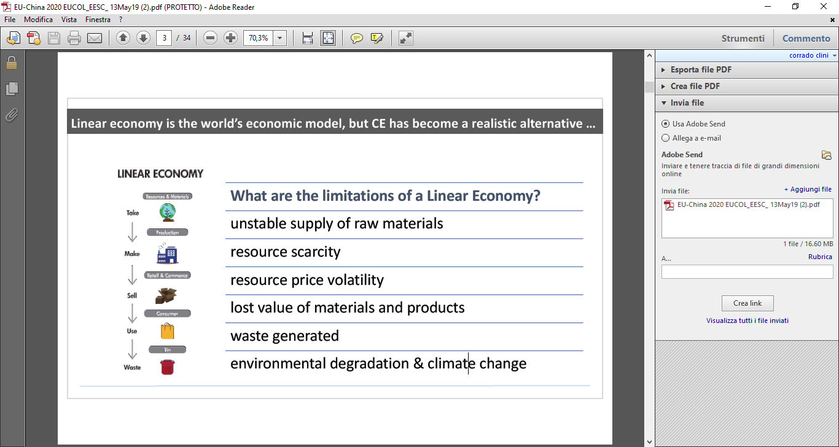

Slide 4
EUROPEAN CIRCULAR ECONOMY ACTION PLAN
Progress and Barriers
In 2015, the European Commission adopted an ambitious Circular Economy Action Plan with the aim to accelerate Europe's transition towards a circular economy. The 54 actions under the action plan cover all the stages of industrial value and supply chains. They are targeted at “closing the loop” of product life-cycles and include measures to develop new market outlets for secondary raw materials. The Action Plan is a balanced mix of voluntary initiatives and regulatory actions
• sectorial actions on plastics, food waste, critical raw materials, construction and demolition, biomass and biobased materials, innovation and investments, monitoring and evaluation;
• guidance on circular economy in the form of Best Available Techniques reference documents (BREFs) covering a first package of key industrial sectors
Eco-design directive and Plastics Strategy
Nevertheless, despite the remarkable acceleration, the transition from linear to circular economy is not easy.
Many recent studies on the progress of CE in Europe have highlighted numerous obstacles and barriers :
Obstructing laws and regulations, mainly taxation and waste management;
High upfront investment costs of building circular economy business models, wich in turn reward linear models;
The high costs of secondary raw materials compared to the lower costs of many virgin materials, “ prevent CE products to outcompete their linear equivalents” (Mont et al. “Business model innovation for a Circular Economy”, 2017);
Hesitant company attitude towards CE and limited circular design : CE is not mainstreamed in the companies business model ;
Lack of consumer demand.

Slide 5
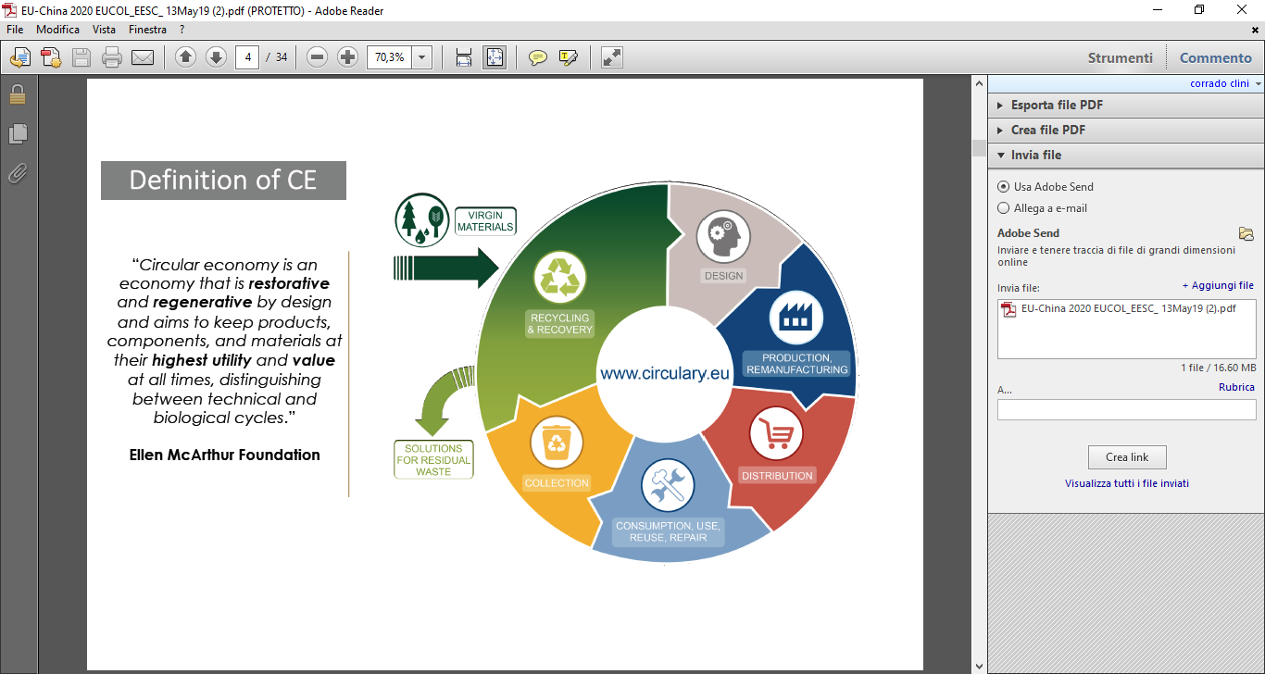
EUROPEAN CIRCULAR ECONOMY STRATEGY

Slide 6
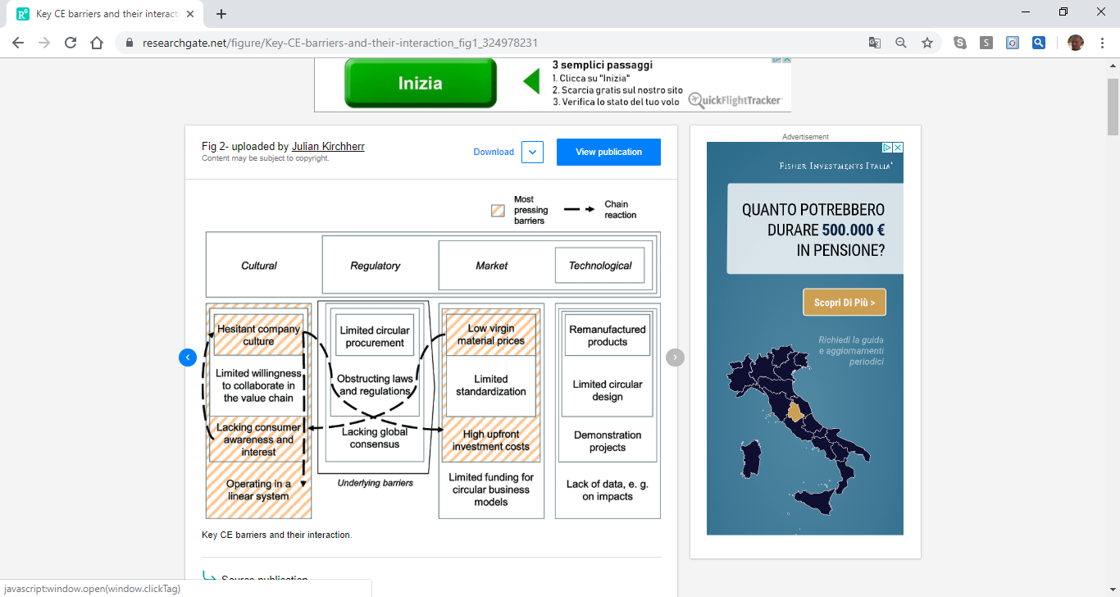
EUROPEAN CIRCULAR ECONOMY ACTION PLAN : BARRIERS AND THEIR INTERACTION
Source : Barriers to the Circular Economy: Evidence From the European Union (Ecological Economics 150 (2018) 264–272)
Julian Kirchherra , Laura Piscicellia , Ruben Boura,b , Erica Kostense-Smitb , Jennifer Mullerb , Anne Huibrechtse-Truijensb , Marko Hekkert (a)
Innovation Studies Group, Copernicus Institute of Sustainable Development, Utrecht University, The Netherlands
Deloitte, The Netherlands

Slide 7
CIRCULAR ECONOMY IS A GLOBAL ISSUE
The Vice President of EU Commission Frans Timmermans, in the opening speech at the European Circular Economy Stakeholder Meeting, argued that international cooperation is essential for the transition to circular economy: it is a global endeavour as “our policies will only have a limited impact on the planet if others pursue opposing policies” (March 6,2019).
The production and consumption patterns in the global economy continue to be predominantly based on the linear models, despite the international environmental agreements, first among all the 2030 Agenda and Sustainable Development Goals. Especially, the flows of secondary raw materials and the costs of virgin materials are not geared towards the circular economy, and this significantly affects the loss of competitiveness of circular business models in all the markets.
Therefore, the barriers already identified in the European market have also been reflected in the global market.

Slide 8
CIRCULAR ECONOMY IS A GLOBAL ISSUE
The role of China and the EU-China Circular Economy Platform
China has a key role to play in promoting a global framework for the transition to the circular economy.
For more than 15 years, China’s has been a frontrunner on CE policies to the point that until 2010 the term could only be found in Chinese policy documents aimed at addressing pollution, promoting resource efficiency, and industrial ecology :
“China: promoting a circular economy” is the final report of the programme financed in 2004 in the framework of the Sino Italian Cooperation for Environmental Protection in China. Law was promulgated on August 29, 2008 and came into force on January 1, 2009.
The Circular Economy Promotion Law came into force on January 1, 2009.
The Circular Development Leading Action Plan (May 2017)
Ban of 24 categories of foreign solid waste imports, such as plastics and unsorted waste paper, (January 2018) The import ban has shown the limits of the global waste management system. However, it also opened up opportunities for innovative circular business models.
13th Five Year Plan “We will stay aware of the need for the economical, efficient, and circular use of resources, bring about a fundamental change in the way resources are utilised, and strengthen conservation management throughout the entire process of resource use, thus significantly raising resources utilization efficiency.”
In this context, the MOU on Circular Economy Cooperation signed at the 20th EU-China Summit (July 2018) is a step forward to challenge the global model of linear economy. The transition to CE in the worlds’ two largest economies would accelerate a global “system shift” towards a circular and regenerative economy.

Slide 9
OVERCOMING THE BARRIERS
A PACKAGE OF INTERNATIONAL JOINT POLICIES AND EFFECTIVE MEASURES TO OVERCOME THE BARRIERS
A PROPOSAL FOR THE EU-CHINA CIRCULAR ECONOMY PLATFORM
‘Obstructing laws and regulations’ :
  International classification and harmonized regulations of secondary raw materials, as well as “material passports”, are needed to exclude secondary raw materials from waste legislation, and to allow their transport and marketing across borders.
  Eco-design criteria and targets of durability, reusability and recyclability of products, are a necessary step to shift from linear to circular economy
‘Lack of competitiveness’ :
  Taxation of virgin materials incorporating all the ‘externalities’ (natural resources and energy) into the price of the final product : such measure is the most sustainable way to support the market of secondary raw materials ( e.g plastics case) as well as the mainstreaming of CE in the business model of the companies
  Tax-incentives to reduce the upfront investment costs are necessary to improve the competitiveness of circular business models in comparison with the linear business models
  Financial support of the technology innovation to improve the recovery and recycling of materials little or improperly reprocessed ( e.g plastics, lead glass, batteries….), whilst introducing high taxation on the same wasted materials, are effective measures for recapturing the economic value of such materials as well as reducing the unsustainable increasing of dangerous wastes
  Sustainable Public Procurement, in order to promote the CE products, is a key driver for the development of circular business model
Lack of consumer demand.
  Standards of CE products to guarantee the same of similar quality of the linear products are a necessary “infrastructure” for addressing the consumer demand
  Mandatory Life Cycle Assessment and Environmental Foot Print of all the products are an effective way for promoting the public awareness on circular economy

Slide 10
THE GREEN SILK ROAD
ITALY-CHINA CIRCULAR ECONOMY PROJECT OVERCOMING THE BARRIERS : The Green Pallets
Heterogeneous polyolefin-based plastic represents over 65% of urban and industrial plastic waste, and it cannot be re-used in normal production processes, much less for injection moulding. This is the main reason of the pervasive plastics pollution of soil and rivers. Thanks to the ROTEAX system – designed by Italian company “PLAXTECH”- this materials can now be recovered, re-used and recycled. This is a concrete and successfully implementation of circular economy. The most encouraging results have come from the production of so-called “green pallets” made entirely from recycled mixed plastic wastes.
The “green” pallets meet all the load specifications, last ten times longer than wooden pallets and, once their life cycle is over, can be processed anew with ROTEAX. The mechanical features of these pallets are identical to those made of virgin homogeneous plastic using traditional technology, but the costs are significantly lower.
TWO MAIN BARRIERS HAVE BEEN OVERCOME : the quality and the cost of CE products
In 2017 the Italian company PLAXTECH signed an agreement with JIANA Environmental Protection Science and Technology based in Dezhou, Shandong, to develop the ROTEAX system in China.
Thanks to the introduction of the ROTEAX system, the Dezhou project
will enable to build a waste plastic management model aimed at recycling and recovering plastic to produce eco-friendly items, beginning with pallets, in line with the Chinese law for the Promotion of Circular Economy,
is consistent with the objectives set with the ban on imported plastic waste in China since January 1st 2018.
LAST BUT NOT LEAST, THE PRODUCTION OF RECYCLED PLASTIC PALLETS WILL HELP TO MEET THE GROWING DEMAND TO REPLACE THE WOOD PALLETS PRODUCED WITH NATURAL AND NON-RECYCLABLE RESOURCES. ( about 1,7 billion units expected in China by 2025)

Slide 11
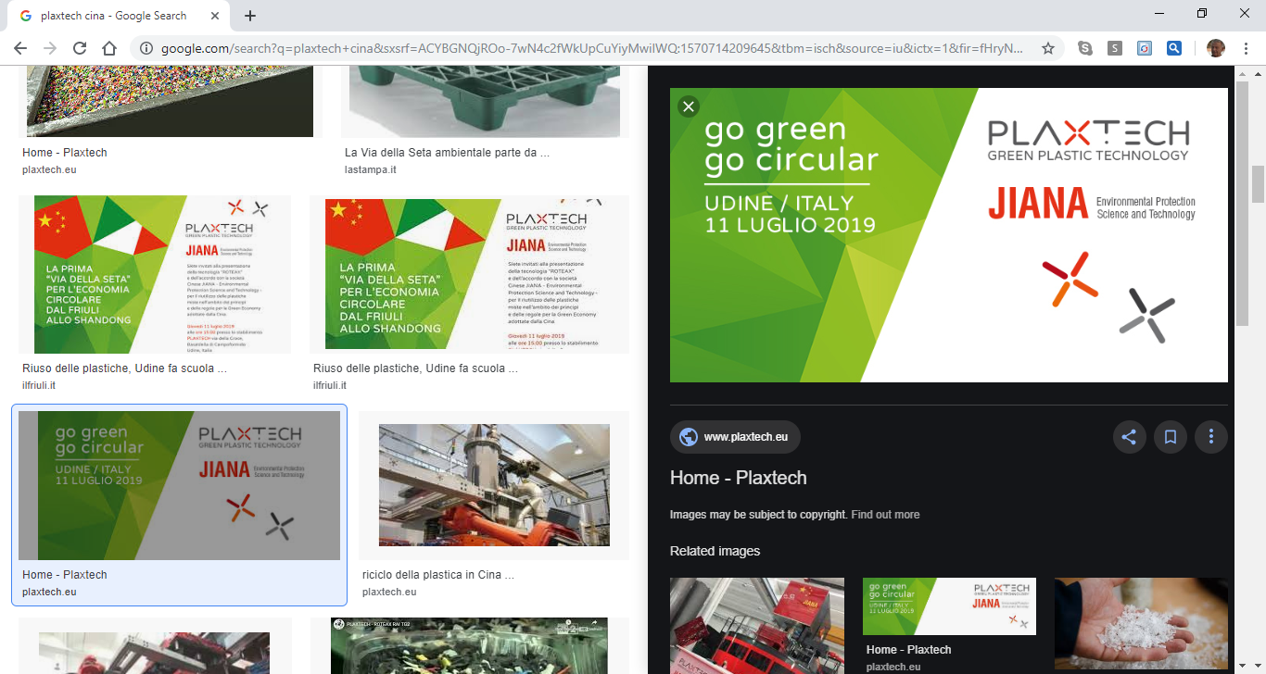

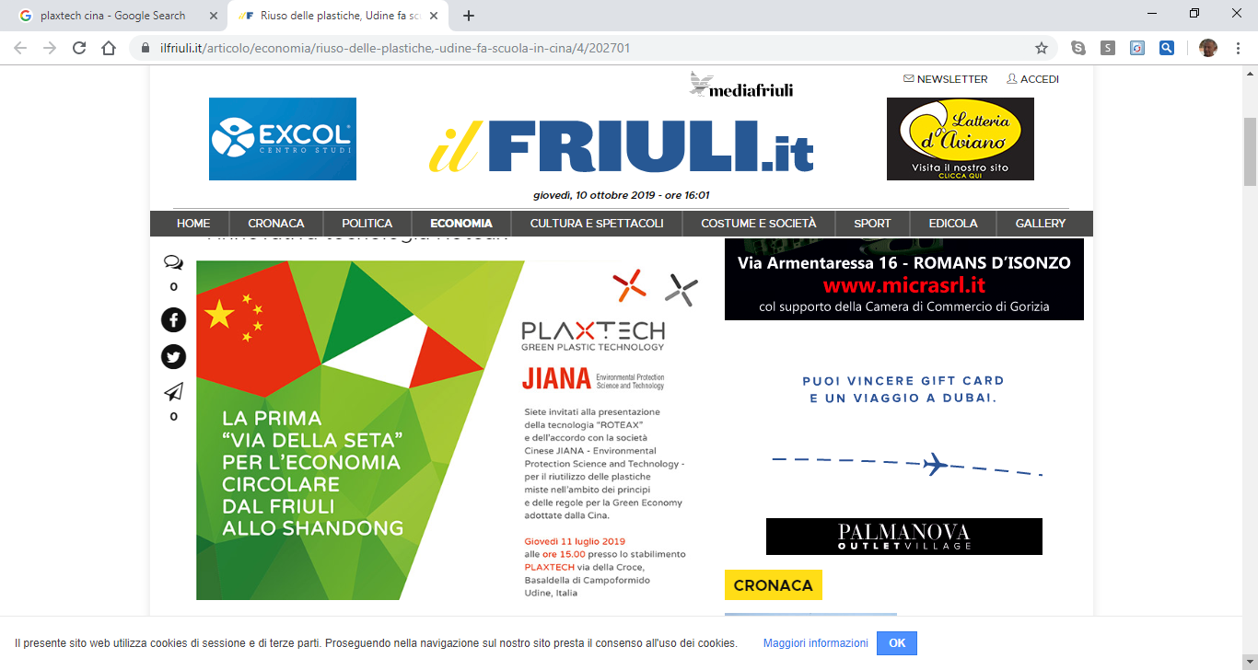

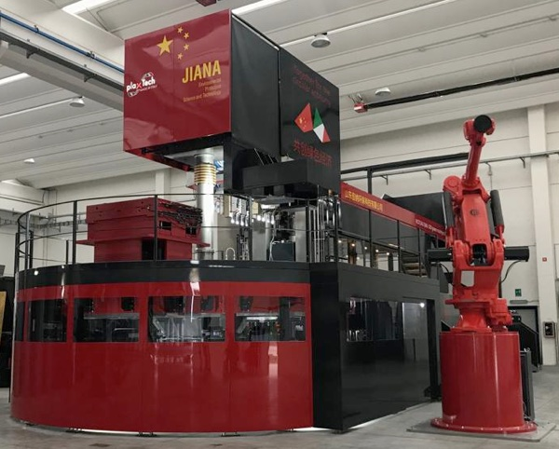
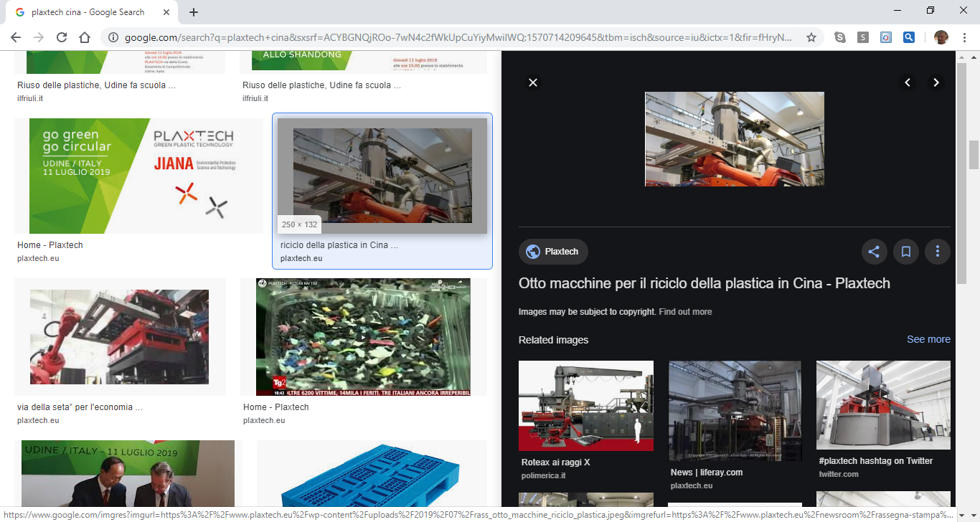
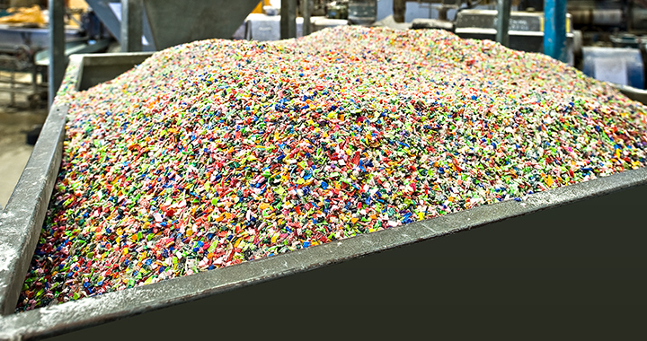
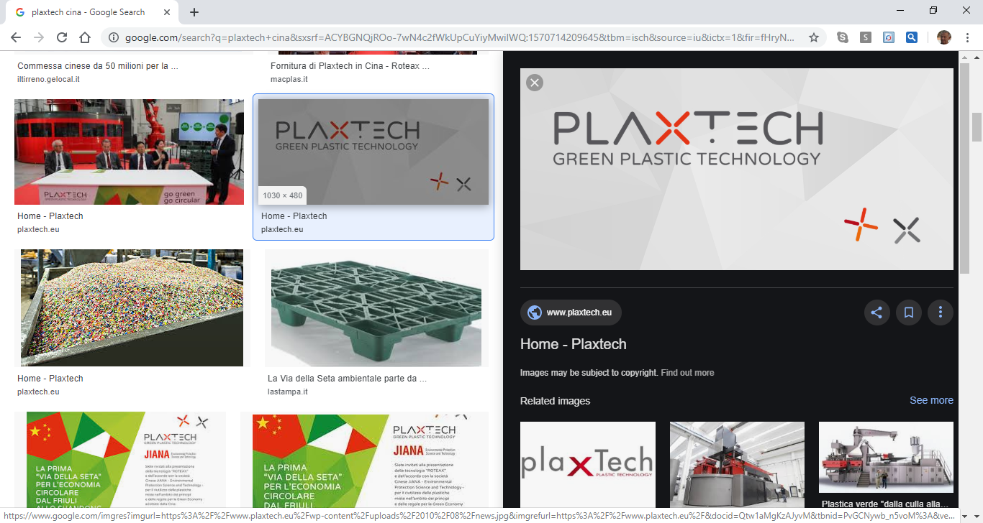

Slide 12
THANK YOU VERY MUCH
WISH GOOD WORK AND GOOD LUCK TO CHINA ASSOCIATION OF CIRCULAR ECONOMY

